Slide 1


Science and Industry in Dialogue

Slide 2


7 FOCAL TOPICS AT A GLANCE!
.

Slide 3

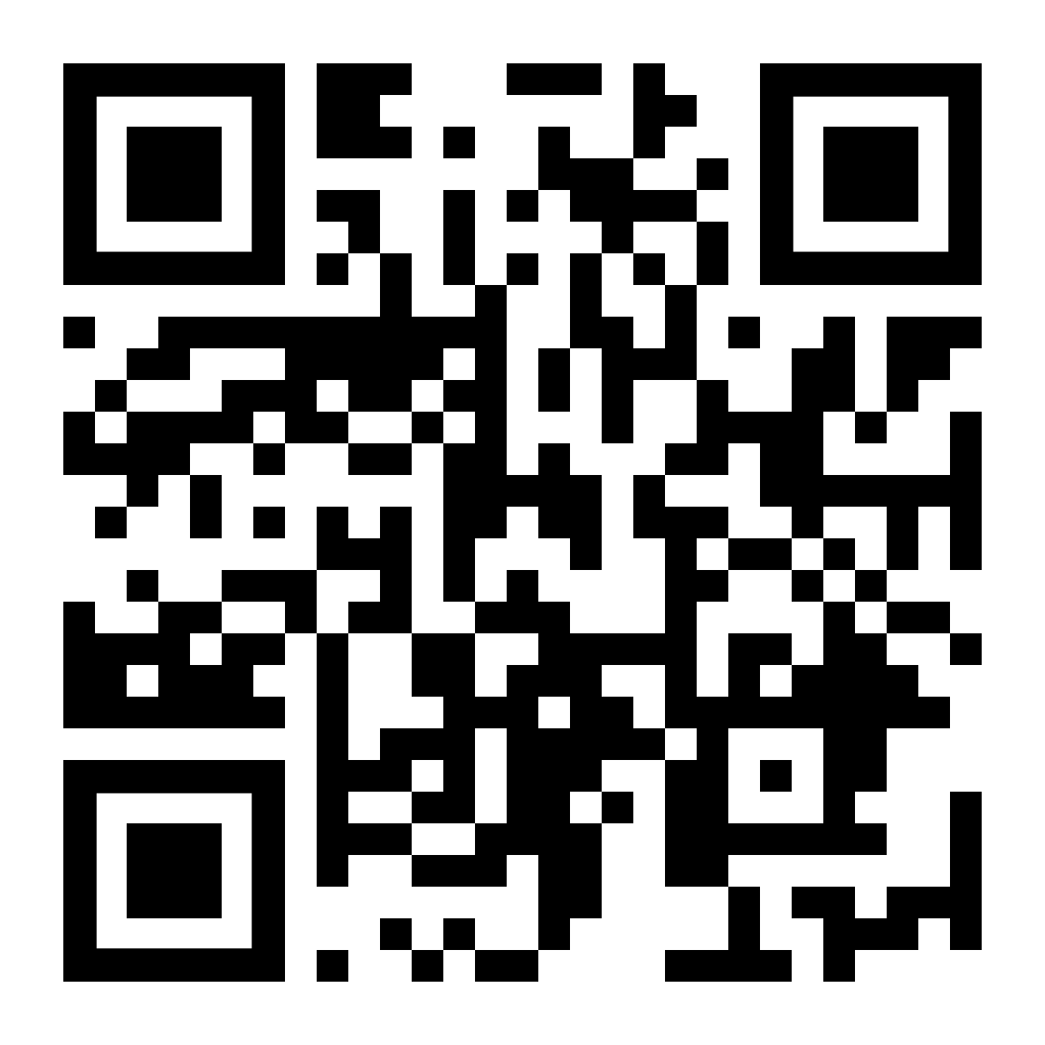
MEMBERSHIP FOR INTERNATIONAL STUDENTS

Slide 4
DECHEMA YOUNG OFFERS YOU
» 11 x “DECHEMA aktuell” online magazine for members only
» Information on (travel) scholarships and calls for awards
» Access to the member area with exclusive offers for students & young professionals
» Access to more than 100 topical working groups - your field of interest is included, too!
» Summer schools and workshops for young scientists
» A network of industry and science
» Online seminars on topics about study and career planning
» Newsletter about topics of interest for you
Part of the offerings are in German language only
SCAN NOW FOR FURTHER INFORMATION!

Slide 5




FIND & FOLLOW US!
www.dechema.de
DECHEMA e.V.
Theodor-Heuss-Allee 25
60486 Frankfurt am Main
Tel. ++49 (0)69 7564-0
presse@dechema.de

